Slide 1
SMART FASHION RECOMMENTATION SYSTEM
Dhanalakshmi Srinivasan Engineering College – Perambalur
Team Id : PNT2022TMID08421
Team Leader: Mohana Subbu M
Team Member 1 : Fakrudeen K
Team Member 2 : Dinesh Kumar K
Team Member 3 : Rakesh A

Slide 2
INTRODUCTION
A recommendation system is an integral part of any modern online shopping or social network platform.
The product recommendation system as a typical example of the legacy recommendation systems suffers from two major drawbacks: recommendation redundancy and unpredictability concerning new items (cold start).
These limitations take place because the legacy recommendation systems rely only on the user’s previous buying behaviour to recommend new items.
Incorporating the user’s social features, such as personality traits and topical interest, might help alleviate the cold start and remove recommendation redundancy.

Slide 3
we propose Meta-Interest, a personality-aware product recommendation system based on user interest mining and meta path discovery.
Meta-Interest predicts the user’s interest and the items associated with these interests, even if the user’s history does not contain these items or similar ones.
This is done by analysing the user’s topical interests and, eventually, recommending the items associated with the user’s interest.
The proposed system is personality-aware from two aspects; it incorporates the user’s personality traits to predict his/her topics of interest and to match the user’s personality facets with the associated items.
The proposed system was compared against recent recommendation methods, such as AI based watson-based recommendation using flask framework is implemented here

Slide 4
PURPOSE
The purpose of the work E- commerce system is implemented for product recommendation system, online based system application is used for purchase. The product recommendation tool use a set of algorithms to show relevant products to your visitors.
They do this by using data like location, gender, and more specific information like purchase intent.

Slide 5
LITERATURE SURVEY
[1] McAuley et al. devised a parametric distance transformation that assigns a lower distance to garment pairings that fit well than to those that do not. And provided Image-based recommendations on styles and substitutes.
[2] Hu et al. conducted a preliminary investigation into personalised outfit recommendation. To describe the user-item and item-item interactions, a functional tensor factorization method was presented. They proposed A functional tensor factorization approach.
[3] Thombre in [3] used image segmentation and Kalman filter to realize Human detection and tracking. Orrite-Urunuela proposed a statistical model for detection and tracking of human silhouette and the corresponding 3D skeletal structure in gait sequences.

Slide 6
LITERATURE SURVEY
[4] Veit et al.learned feature transformation for a compatibility measure between pairs of objects using a Siamese CNN architecture. All of these works focused solely on the compatibility of two things. Furthermore, they simply modelled broad matching criteria and ignored the issue of personalisation.
[5] Ajmani et al. present a novel method for contentbased recommendation of media-rich commodities with the use of probabilistic multimedia ontology. Proposed an ontology based personalized garment recommendation system.
[6] Li et al. utilized the HMM of recommended items to match customers’ model according to customer data. The second method is the collaborative filtering-based recommendations algorithm. Proposed Content-Based Filtering Recommendation Algorithm

Slide 7
LITERATURE SURVEY
[7] For instance, Nogueira et al.presented a new collaborative filtering strategy that utilizes the visual attention to characterize images and alleviate the new item cold-start problem. The rule-based recommendation algorithm is the third method.
[8] Hwang et al. put forward a method to generate the automatic rules with the user’s items and made a suggestion on the best rule. The fourth method is the utility-based recommendation.
[9] Scholz et al. found that exponential utility functions are better geared to predicting optimal recommendation ranks for products, and linear utility functions perform much better in estimating customers’ willingness.
[10] Koenig in developed a system toward real-time human detection and tracking in diverse environments. However, mostly the researchers focus on the point of human detection and tracking in complex scene, while refined contour extraction of human in dynamic scene is still an open question.

Slide 8
EXISTING PROBLEM
In existing system only simple web application and their rating has been implemented in existing system, an ecommerce product recommendation engine is a piece of technology that displays recommended products to shoppers throughout your store.
It uses machine learning to get smarter and show increasingly relevant products to shoppers based on their interests and previous browsing behaviour.

Slide 9
THE CONTENT-BASED FILTERING METHOD
In existing model is content based filtering scheme has been employed in existing model The content-based filtering method analyzes customer data on the likes and dislikes of each user (cookies allow tracking over multiple visits), then makes recommendations based on the browsing history of that user.
The idea behind content-based filtering is that if you enjoy a certain item, you’ll likely also enjoy a similar item.
An example of a content-based filtering system would be if you were listening to Pandora and consistently ‘liked’ down tempo jazz music.

Slide 10
THE COLLABORATIVE-FILTERING METHOD
The collaborative-filtering method incorporates data from users who have purchased similar products, then combines that information to make decisions about recommendations.
The advantage to this filtering method is that it is capable of making complex recommendations on items such as music or movies without having to ‘understand’ what the item is.
This method of filtering operates under the assumption that users will prefer recommendations that are based on purchases they made in the past.
Here’s an example: If customer A likes a specific line of products that customer B also likes (assuming they have similar interests), then collaborate-filtering would assume that customer A would like other products that customer B purchased and vice versa.

Slide 11
A HYBRID METHOD
A hybrid method combines the content-based and collaborative-based methods to incorporate group decisions but focuses the output based on the attributes of a specific visitor.
An example of a hybrid filtering system would be how Spotify curates its personalized ‘Discover Weekly’ playlists. If you’ve ever listened to a personalized Spotify playlist, it’s shocking how accurately they’re able to recommend songs based on what you like.
The secret behind how they pull this off is through a complex hybrid filtering system that aggregates data on your listening habits as well as similar users’ listening habits, to create a playlist of unique songs that align with your personal taste.

Slide 12
PROBLEM STATEMENT DEFINITION
The problem of the work is to design static web applications deployments with customer deployment
Lack of interaction between application and user
User need to navigate across multiple pages to choose right product
Confusion in choosing product
Lack of sales
Complex User Interface.
Lack of proper guidance.

Slide 13
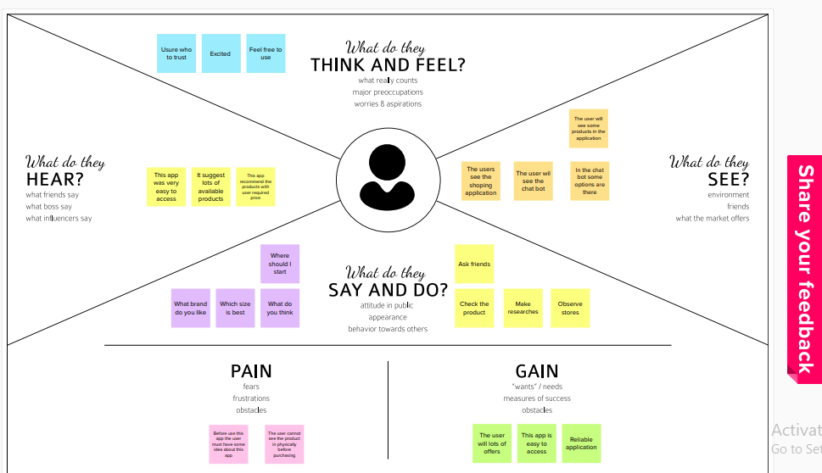
IDEATION AND PROPOSED SOLUTION
EMPATHY MAP CANVAS

Slide 14
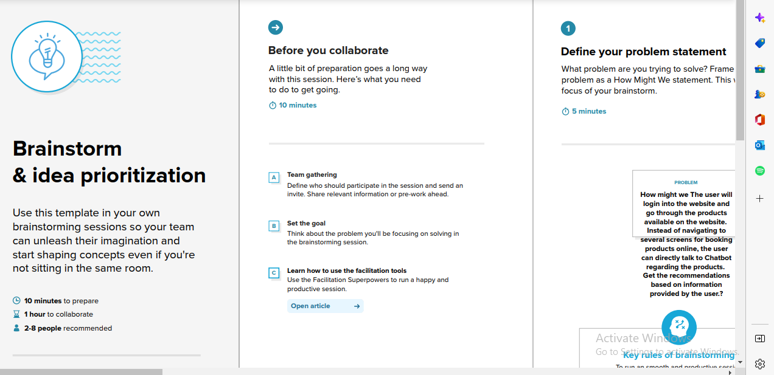
IDEATION AND BRAIN STORMING

Slide 15
PROPOSED SOLUTIONS
The proposed solutions web-based Chabot based applications is implemented with dash board applications is implemented for web applications.
The aim of this research is to build a perfume recommendation system. This system will help the user to get required perfumes. For that user has to provide description as a search query about the perfume according to his interest.
This description can contain feelings, emotions, description, likes, dislikes and brand of the perfume. A chat bot will help the user to get the input in the form of search query and then provide the output as a recommended perfume what user is looking for. Initial work for research is collecting a data.
Data required for this research contained the details in the form of name, brand, text descriptions, reviews, a list of notes.
As we are using natural language processing, the text data must be pre-processed. It covers some tasks like making text data to lower case, removing stop words, tokenization, stemming, etc. shows tasks of pre-processing of data. Lowercasing – Lowercasing is the first step in data

Slide 16
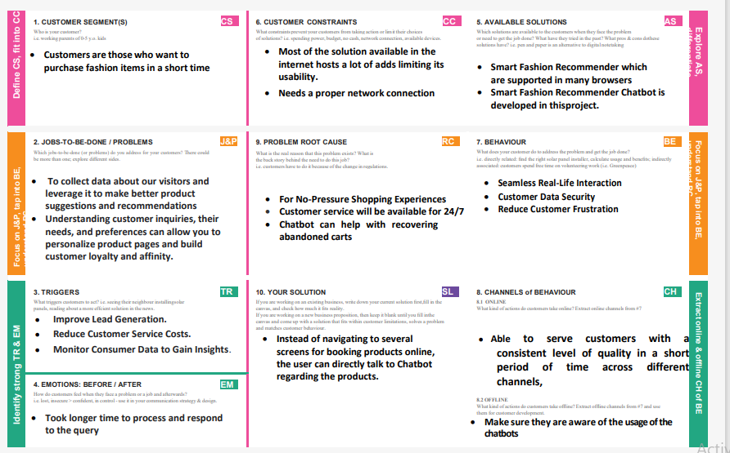
PROBLEM SOLUTION FIT

Slide 17
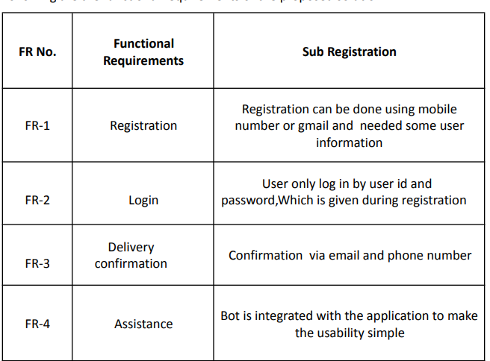
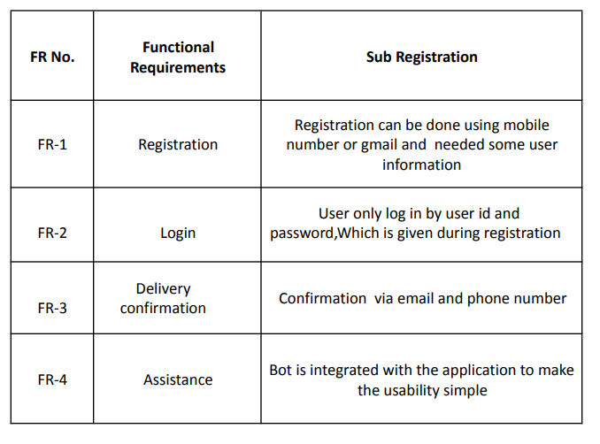
REQUIREMENT ANALYSIS
FUNCTIONAL REQUIREMENT
[A] [B]

Slide 18
NON -FUNCTIONAL REQUIREMENT
A Data Flow Diagram (DFD) is a traditional visual representation of the information flows within a system.
A neat and clear DFD can depict the right amount of the system requirement graphically.
It shows how data enters and leaves the system, what changes the information, and where data is stored.

Slide 19
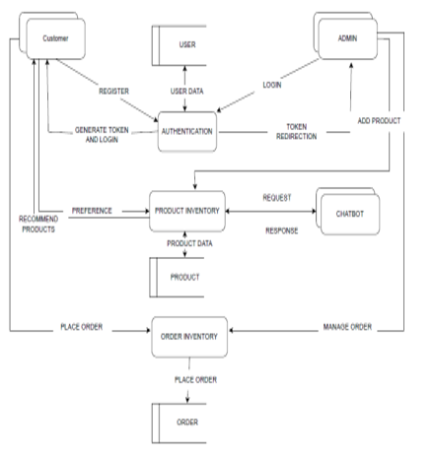
PROJECT DESIGN
DATA FLOW DIAGRAMS

Slide 20
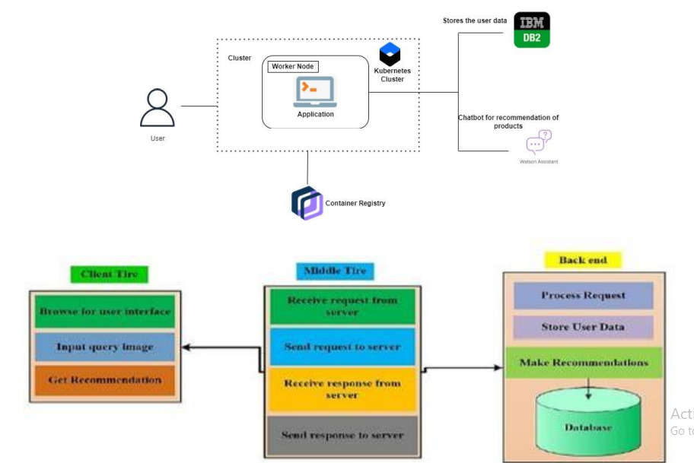
SOLUTIONS AND TECHNICAL ARCHITECTURE

Slide 21
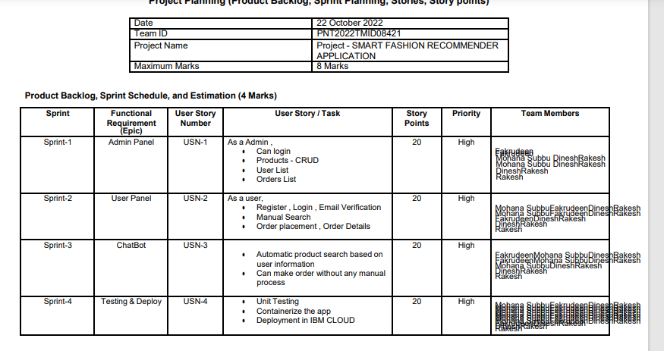
PROJECT PLANNING AND SCHEDULING

Slide 22
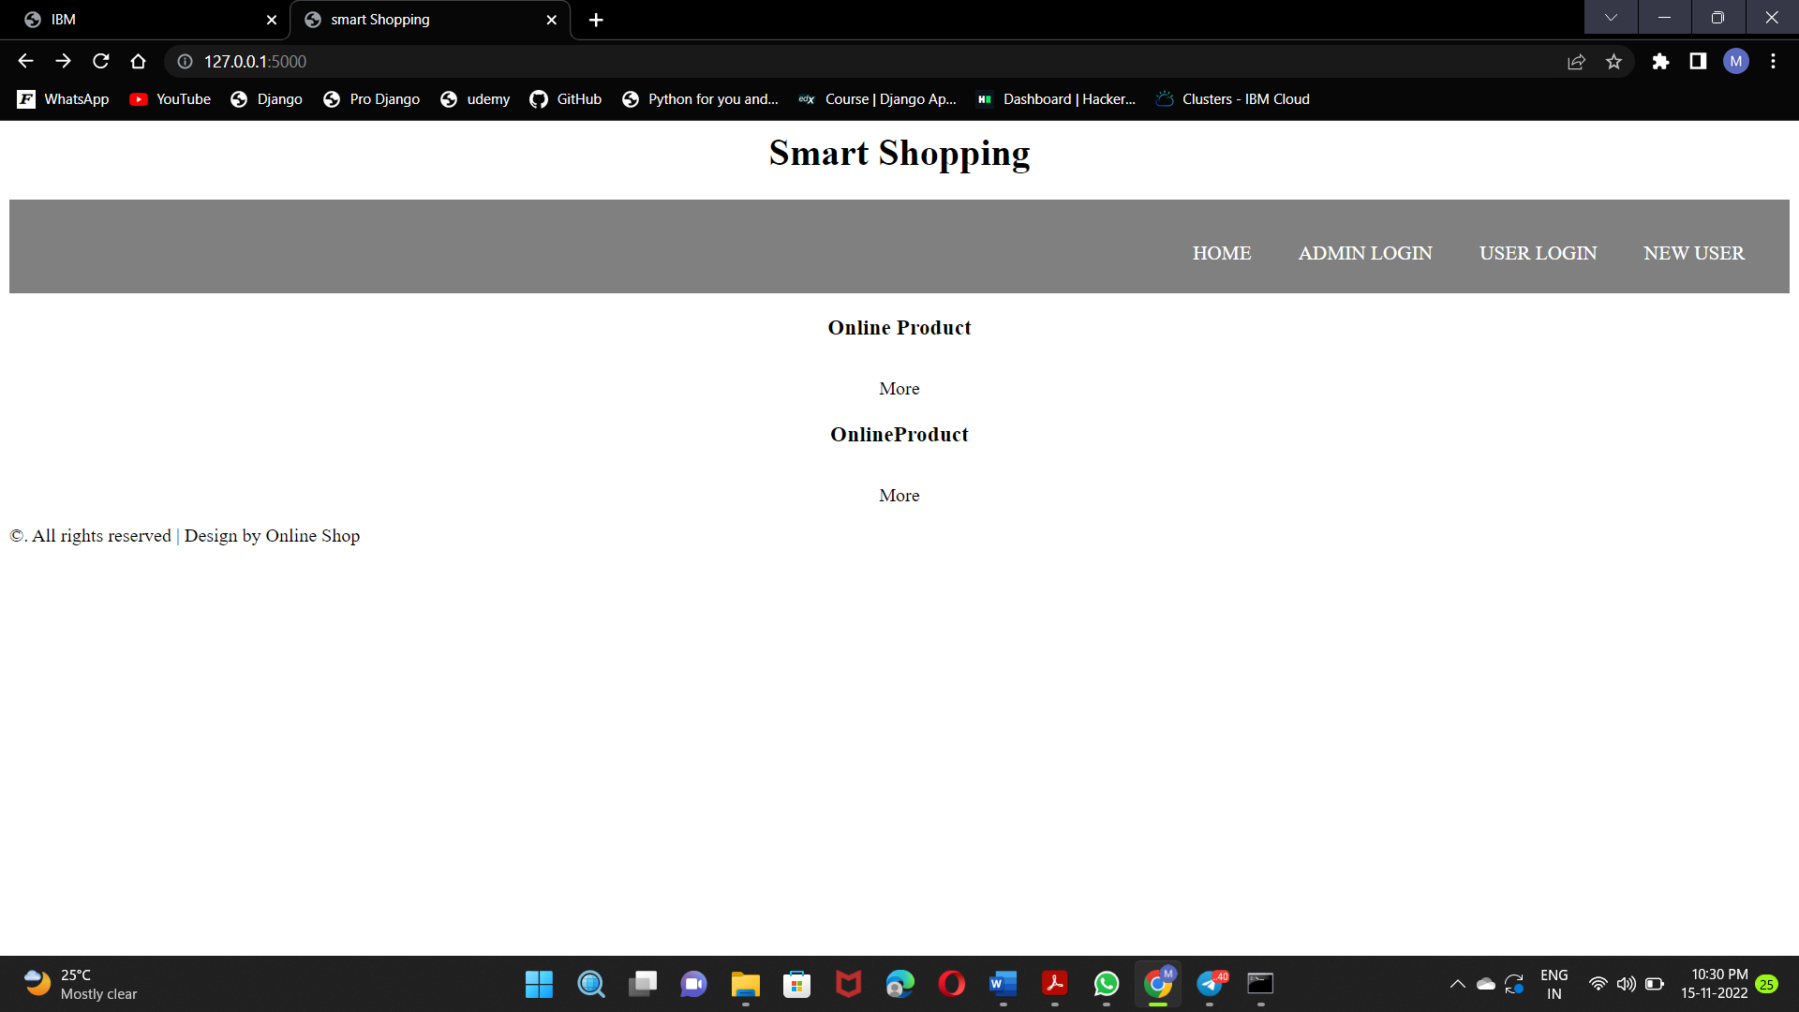
OUTPUT
HOME PAGE

Slide 23
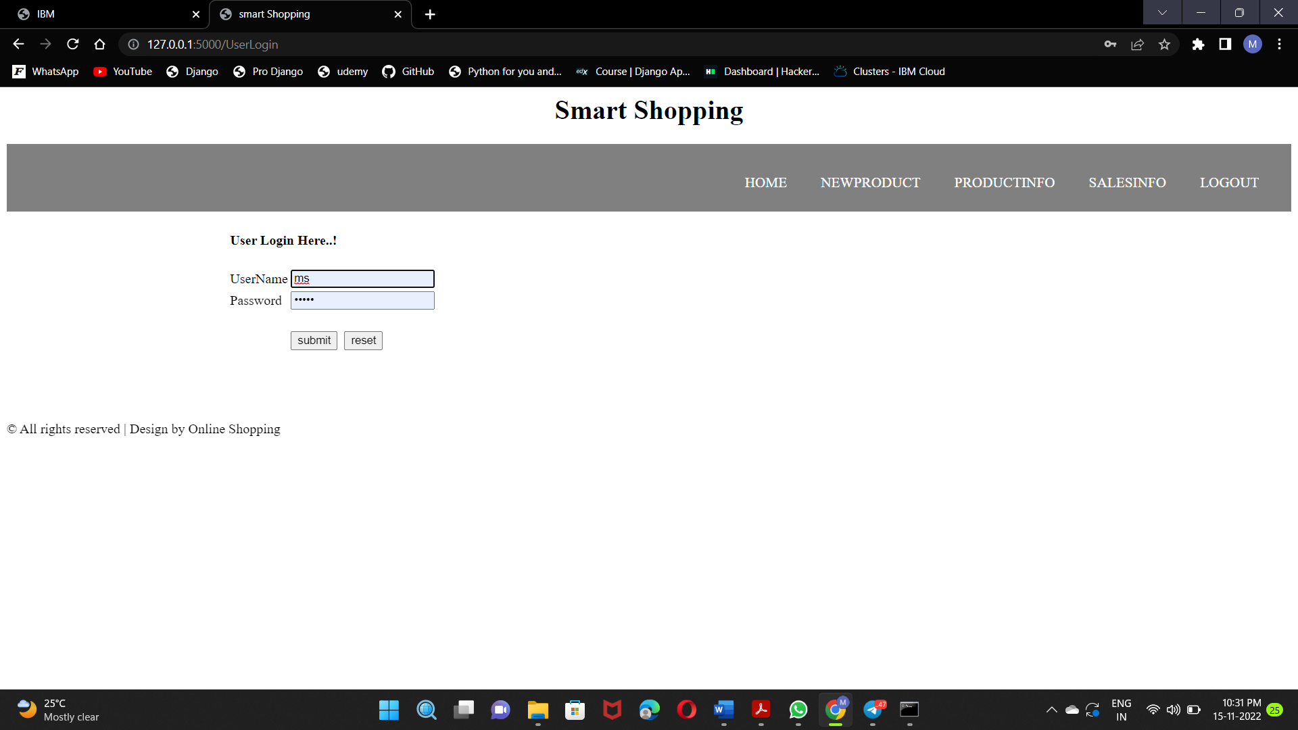
USER LOGIN

Slide 24
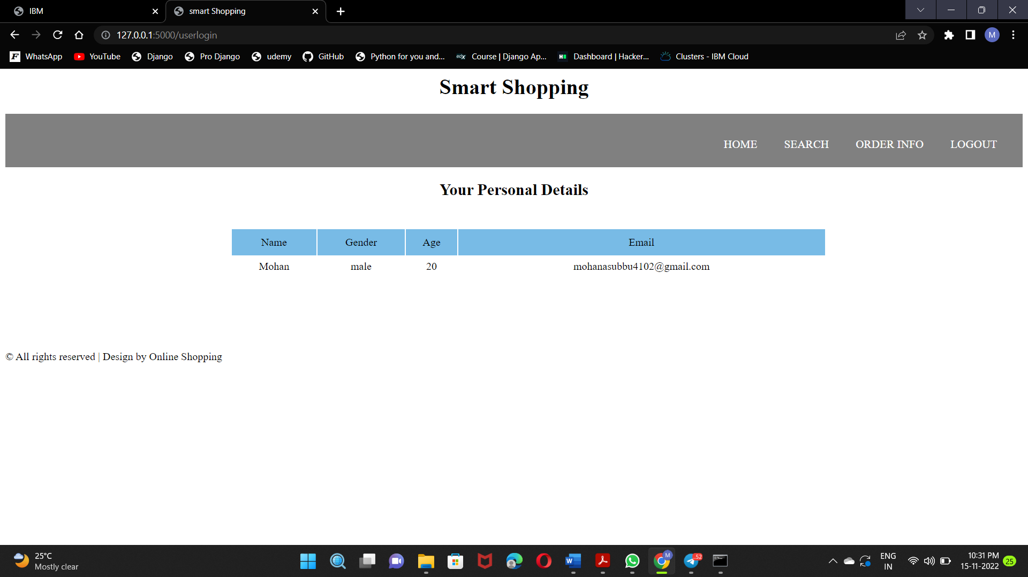
User Dashboard

Slide 25
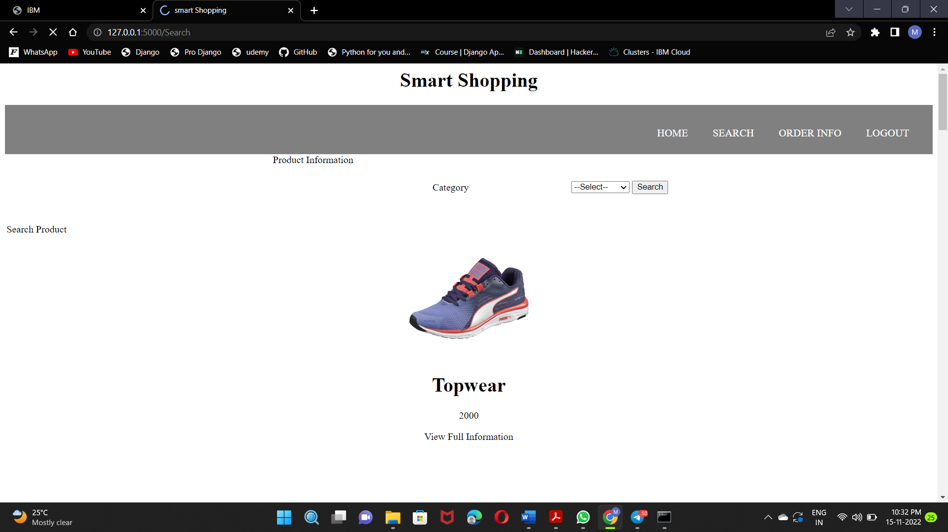
Products Page

Slide 26
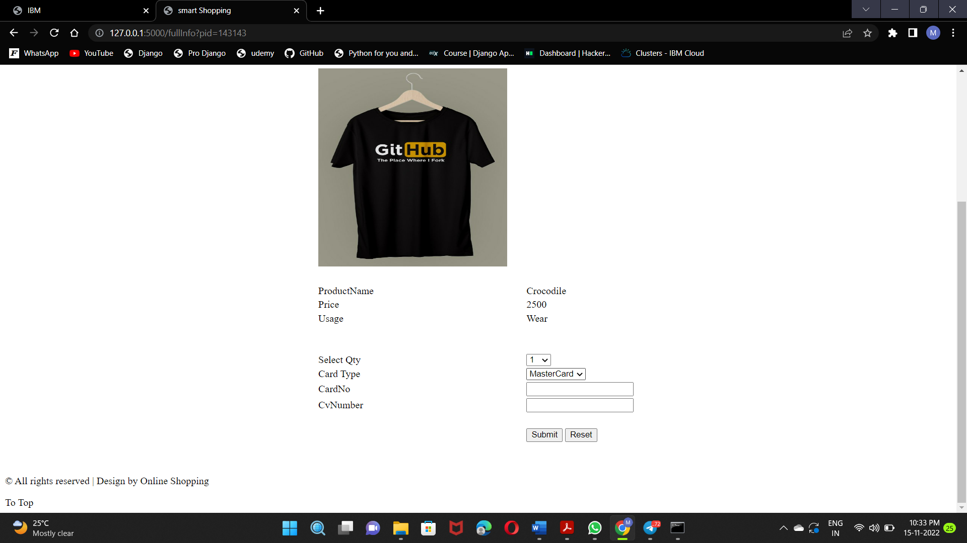
Product Buying Page

Slide 27
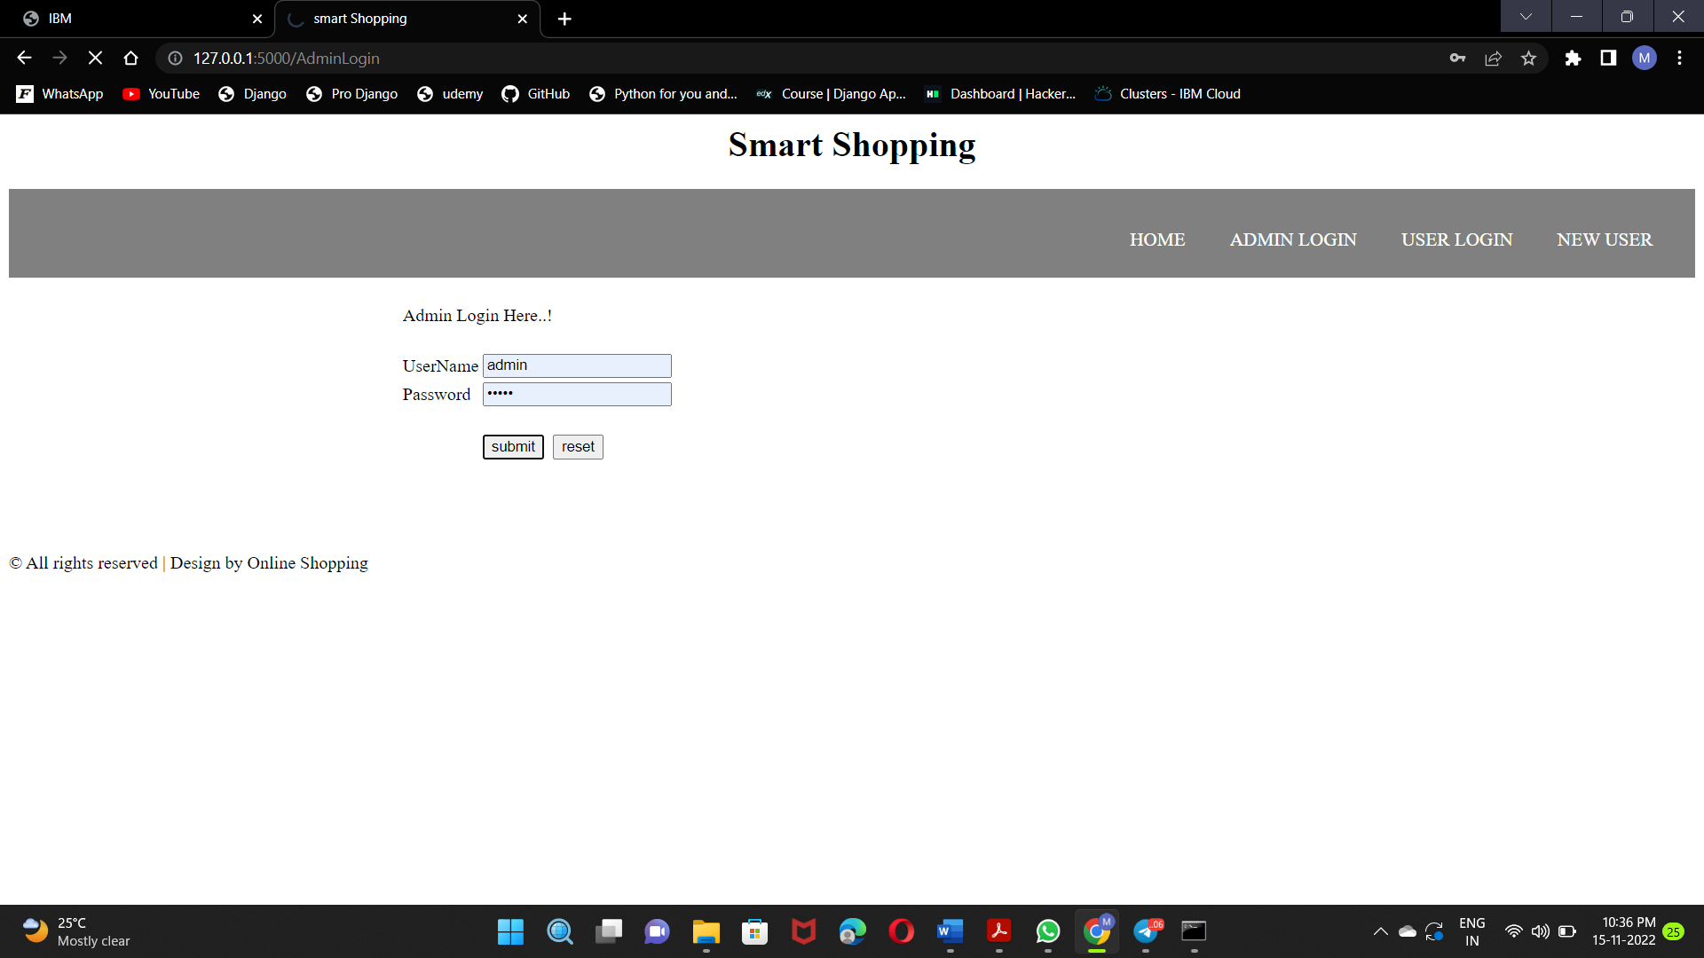
Admin Login Page

Slide 28
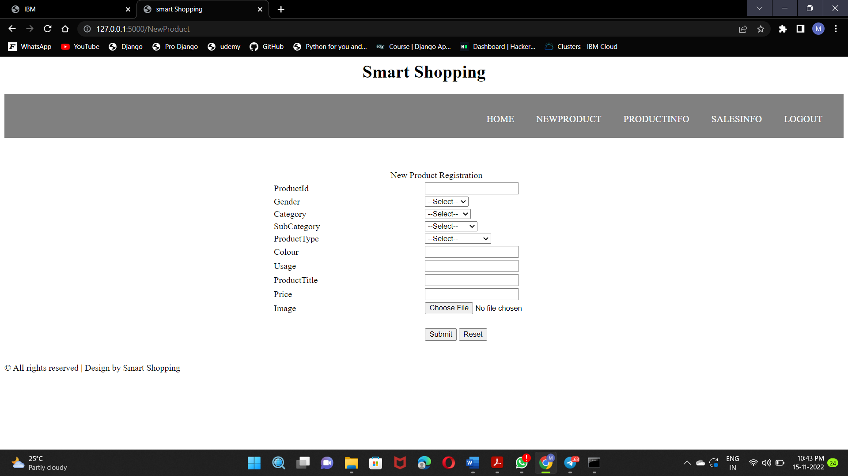
Product Add Page

Slide 29
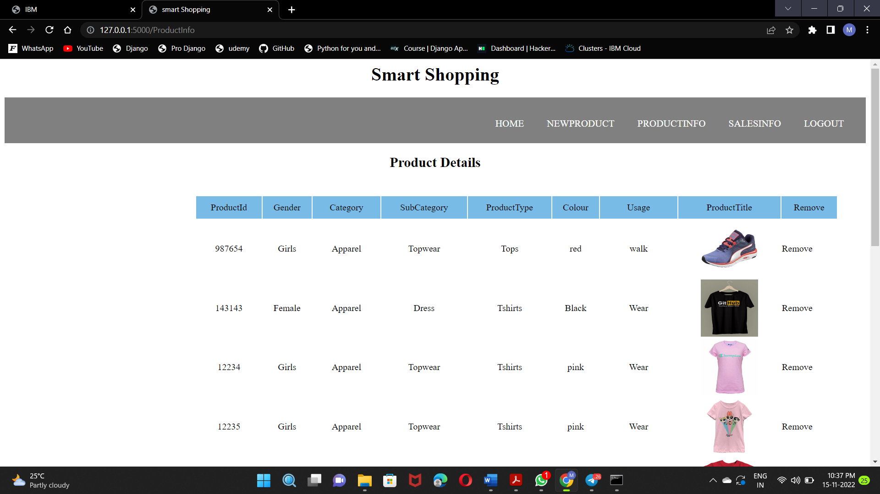
Products Page

Slide 30
ADVANTAGE AND DISADVANTAGES
Good customer satisfaction.
The performance is better in terms of quality and time.
It provides the better use of the database which store user and product history.
Quality prediction, Scalability, Prediction, speed are the main advantages of the proposed scheme.

Slide 31
CONCLUSIONS
In we developed product recommendation system using chat bot-based applications we developed here recommend the product list , Recommender Systems have been widely used to exhibit the most appropriate items to users given their past consumption preferences.
Recommendation systems are achieving great success in e-Commerce applications, during a live interaction with a customer; recommendation system may apply different techniques to solve the problem of making a correct and relevant product recommendation using chat bot Flask framework designed here for product recommendation system.

Slide 32
FUTURE WORK
In future work we designed the android based mobile applications for product recommendation.

Slide 33
REFERENCES
I. Esslimani, A. Brun, and A. Boyer, “A collaborative filtering approach combining clustering and navigational based correlations,” in Proc. 5th Int. Conf. Web Inf. Syst. Technol., 2009, pp. 364–369
S. Zhang, W. Wang, J. Ford, and F. Makedon, “Learning from incomplete ratings using non-negative matrix factorization,” in Proc. 6th SIAM Int. Conf. Data Mining, 2006, pp. 549–553.
T. Hofmann and J. Puzicha, “Latent class models for collaborative filtering,” in Proc. 6th Int. Joint Conf. Artif. Intell., 1999, pp. 688–693.
B. M. Sarwar, G. Karypis, J. A. Konstan, and J. Reidl, “Item-based collaborative filtering recommendation algorithms,” in Proc. 10th Int. World Wide Web Conf., 2001, pp. 285–295
T. George and S. Merugu, “A scalable collaborative filtering framework based on co-clustering,” in Proc. 5th IEEE Int. Conf. Data Mining, 2005, pp. 625–628

